Slide 1
Oil Spill Response in Fast Water
CGPRT(W) : Ensuring Clean Seas and Coasts in Western Region ……

Slide 2
Objective
To understand the basics of fast current response
To enable you to develop fast water response strategies in either open water or fast water from the perspective of the incident command
To consider how these strategies may be applied within the incident command system
To be aware of the specific safety issues when working near fast water
CGPRT(W) : Ensuring Clean Seas and Coasts in Western Region ……

Slide 3
Introduction
Fast water refers to any situation where river, harbour or estuary surface current velocities are expected to exceed 1 (one) knot
This module will consider both Fast Water and Open Water response where surface currents exceed 1 (one) knot
This level considers fast water response from the Incident Command perspective
Operational fast water procedures are covered in Level 1
CGPRT(W) : Ensuring Clean Seas and Coasts in Western Region ……

Slide 4
Open Water Containment
We have seen how booms may fail operationally in five main modes
In respect of Open Water we will focus on two of the failure modes:
  Entrainment
    Typically occurs when the velocity difference between the boom and the water surface exceeds 0.35 – 0.5 m/s (approximately 0.7 – 1.0 knots)
  Drainage
    Occurs at around 0.7 knots in deep water
CGPRT(W) : Ensuring Clean Seas and Coasts in Western Region ……

Slide 5
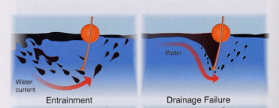
Open Water Containment
Source: Fingas, “The Basics of Oil Spill Clean-up” 2001
CGPRT(W) : Ensuring Clean Seas and Coasts in Western Region ……

Slide 6
Open Water Containment
We can reduce the likelihood of these failure types by reducing the boom speed through the water to less than 0.7 knots
This can be achieved by skilful handling of the vessels involved and reducing the relative velocity between the boom and tide/current
This requires a high level of seamanship especially when manoeuvring multiple vessels and altering or reversing course with boom deployed
CGPRT(W) : Ensuring Clean Seas and Coasts in Western Region ……

Slide 7
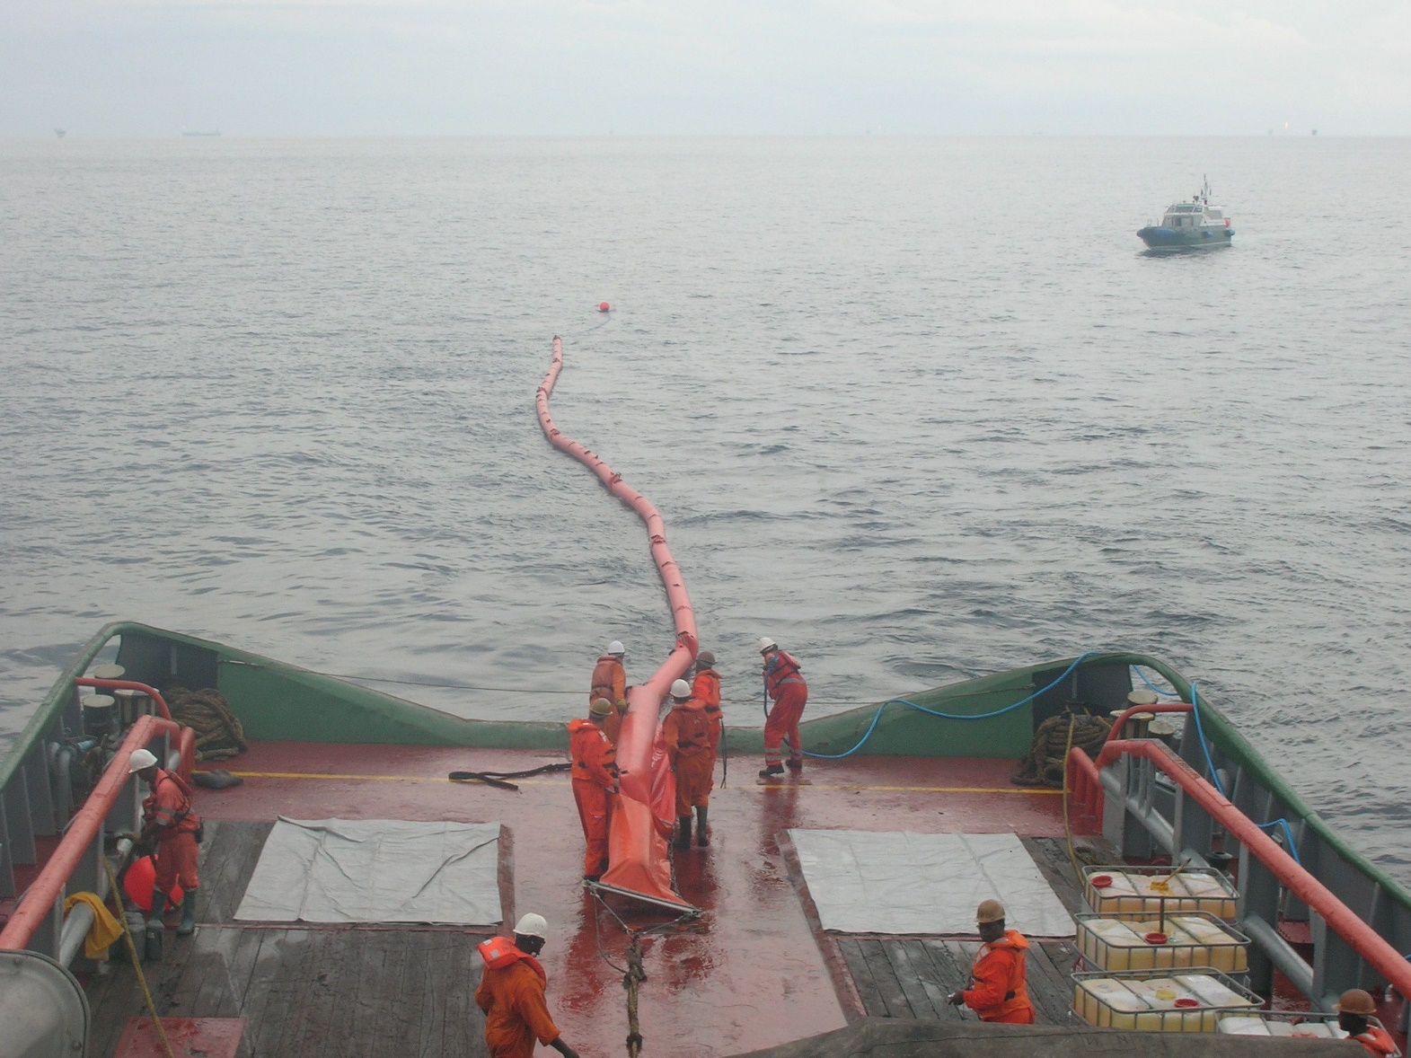
Open Water Containment
Source: CEDRE
CGPRT(W) : Ensuring Clean Seas and Coasts in Western Region ……

Slide 8
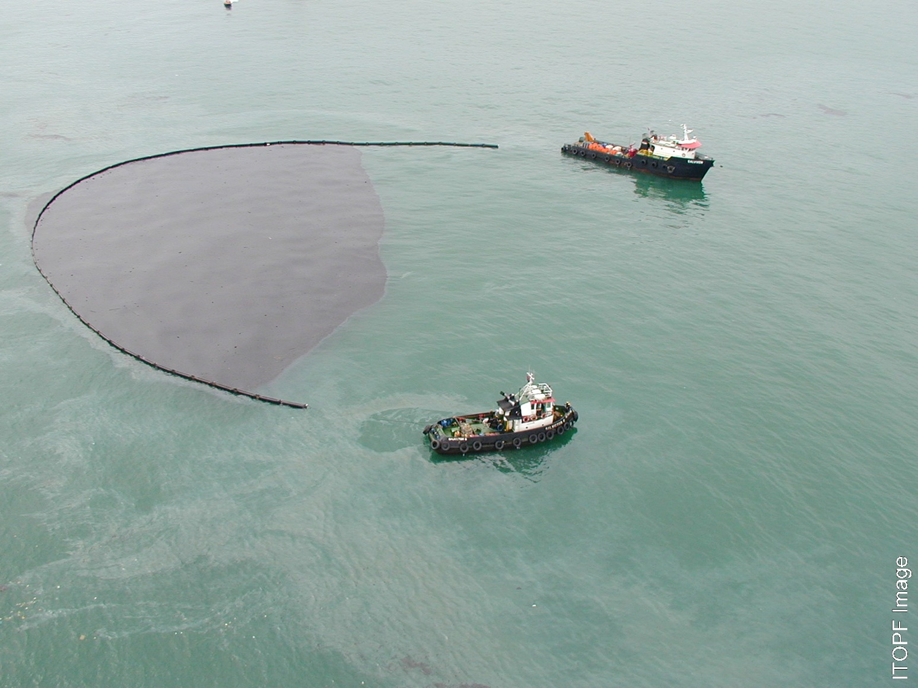
Open Water Containment
CGPRT(W) : Ensuring Clean Seas and Coasts in Western Region ……

Slide 9
Open Water Containment
Requires continuous monitoring:
  Boom tensions
  Wave height
  Wave direction
  Wind direction and speed
  Relative wind direction and speed
  Tide/current rate and direction
  Vessel(s) speed
  Distances between vessels (if appropriate)
CGPRT(W) : Ensuring Clean Seas and Coasts in Western Region ……

Slide 10
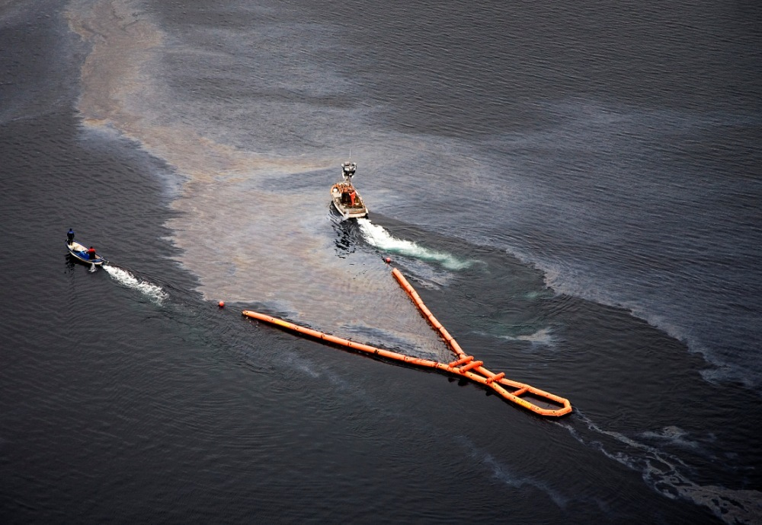
Open Water Containment
There have been some technical developments in boom design and manufacturing that have raised the entrainment loss limit
Source: NOFI
CGPRT(W) : Ensuring Clean Seas and Coasts in Western Region ……

Slide 11
Open Water Containment
An understanding of current and tidal patterns can be gained by referring to local charts and publications
However local knowledge is invaluable for understanding the local current patterns, tidal flow, etc
Relevant local knowledge can be accessed through the employment of local fishermen and other water users
CGPRT(W) : Ensuring Clean Seas and Coasts in Western Region ……

Slide 12
Fast Water
Local knowledge is equally important when considering Fast Water containment in rivers, river mouths, estuaries and harbour mouths
Our objective is to select a containment area where a lower current exists
CGPRT(W) : Ensuring Clean Seas and Coasts in Western Region ……

Slide 13
Fast Water
Natural collection sites should be identified and categorized in the contingency planning process
These typically occur where there is a stagnation zone in the river flow
Identification of there zones will require a survey and testing
These can be validated during the shoreline survey phase of a response in case of seasonal variances or recent developments with access, etc
CGPRT(W) : Ensuring Clean Seas and Coasts in Western Region ……

Slide 14
Fast Water
Areas where debris tends to collect indicate natural collection points,
Viable sites should have good access, sufficient depth for boom and vessel operations and good mooring for booms and anchors
Debris which will impede recovery operations, therefore cleaning the site prior to the arrival of oil is strongly recommended
CGPRT(W) : Ensuring Clean Seas and Coasts in Western Region ……

Slide 15
Fast Water
Accurate determination of current direction and velocity is important for selecting the appropriate tactics to be employed and for correct equipment deployment
Current metres and timing of floating debris over a measured distance can assist calculation of the current velocity
Current velocity can also be estimated by observing the incline of buoys, floating debris and the turbulence around buoys and pilings
CGPRT(W) : Ensuring Clean Seas and Coasts in Western Region ……

Slide 16
Fast Water
Local knowledge is critical, especially in tidal conditions where the current direction and velocity can be very variable
Sources of local knowledge include:
  Harbour pilots
  Local fishermen
  Local Coast Guard, life-saving or water police
  Local water users
CGPRT(W) : Ensuring Clean Seas and Coasts in Western Region ……

Slide 17
Hydrodynamic Considerations
Rivers and canals
  Current velocities are highest in the deep channels of the river and diminish as depth decreases near shore, due to bottom friction effects
  Oil will generally follow the higher current flow downriver
  It will be distributed much like river debris in areas where slow current, eddies, etc. exist
  Differential surface velocities tend to separate and stretch the oil slick into elongated ribbons over long distances downstream
CGPRT(W) : Ensuring Clean Seas and Coasts in Western Region ……

Slide 18
Hydrodynamic Considerations
Rivers and canals (contd.)
  Changes in water levels due to runoff and dam release can dramatically change the currents and flow patterns.
  Containment and Recovery Plans should anticipate seasonal variances and changes in water levels
  Collection points may have to be relocated if significant changes in river height occur during operations
CGPRT(W) : Ensuring Clean Seas and Coasts in Western Region ……

Slide 19
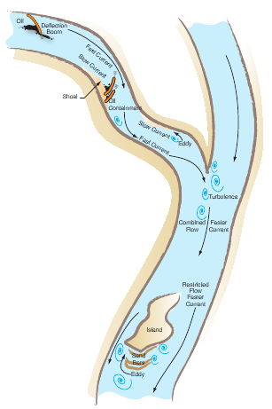
Typical River
Flow patterns
Fast current
Slow current
Eddy
Turbulence
CGPRT(W) : Ensuring Clean Seas and Coasts in Western Region ……

Slide 20
Hydrodynamic Considerations
Tidal inlets
  Inlets, attached bays and tributaries are generally environmentally sensitive areas that must be protected during flood tides to prevent oil from entering
  Tides will significantly complicate response operations
  Tidal effects requires the constant tending of deflection booms and often requires the re-positioning of equipment on each tidal cycle
CGPRT(W) : Ensuring Clean Seas and Coasts in Western Region ……

Slide 21
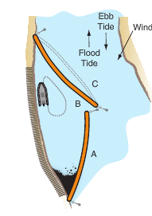
Tidal Entrances
Boom that protects during flood tide
Boom that protects during ebb tide
Position of boom B during flood tide
Source: National Spill Control School
CGPRT(W) : Ensuring Clean Seas and Coasts in Western Region ……

Slide 22
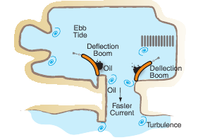
Harbour Flow Patterns – Ebb
CGPRT(W) : Ensuring Clean Seas and Coasts in Western Region ……

Slide 23
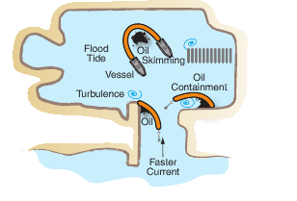
Harbour Flow Patterns – Flood
CGPRT(W) : Ensuring Clean Seas and Coasts in Western Region ……

Slide 24
Hydrodynamic Considerations
Tidal inlets (contd.)
  In rivers open to the sea, the ebb (outward) current is usually stronger than the flood (inward) current due to fresh water runoff
  Rains will dramatically increase ebb tides while diminishing and delaying flood tides
  Local conditions can dramatically change the time and magnitude of maximum currents and slack water
  Strong onshore winds can pile up water in coastal areas and increase tidal range and currents
CGPRT(W) : Ensuring Clean Seas and Coasts in Western Region ……

Slide 25
Incident Command
  Each objective requires careful planning, selection and deployment of resources
  Close cooperation between Operations, Planning and Logistics functions
Command Function
Planning Function
Logistics
Function
Finance Function
Operations Function
Response
Planning
Booming
Operations
At-Sea Recovery
Near-shore Containment & Recovery
Resource Deployment
CGPRT(W) : Ensuring Clean Seas and Coasts in Western Region ……

Slide 26
Tactical Considerations
In summary:
Is it technically reasonable?
Does it meet our NEBA criteria and considerations?
Is it allowed under our regulations?
Do we have the resources?
Can we monitor the effectiveness?
Note: Risk assessment of current and expected conditions in addition to NEBA
CGPRT(W) : Ensuring Clean Seas and Coasts in Western Region ……

Slide 27
Tactical Decision Guide
CGPRT(W) : Ensuring Clean Seas and Coasts in Western Region ……

Slide 28
Safety Considerations
Oil spill response is an inherently hazardous operation and involves handling heavy equipment in proximity to a hazardous material, often under less than ideal sea and weather conditions
Deploying, operating and retrieving heavy and cumbersome equipment, often on oil covered decks or shorelines, requires physical exertion and subjects responders to heat and cold stress
CGPRT(W) : Ensuring Clean Seas and Coasts in Western Region ……

Slide 29
Safety Considerations
Responding to spills in fast water environments imposes additional hazards due to the extreme loads placed on equipment and the danger of personnel being swept away in fast currents
Oil is a hazardous material, posing skin contact and inhalation risks
Before operations a risk assessment should be performed
CGPRT(W) : Ensuring Clean Seas and Coasts in Western Region ……

Slide 30
Safety Considerations
Risk should be assessed considering the likelihood of encountering the hazards and the severity of the consequence
Likelihood | Consequence
 | Insignificant | Minor | Moderate | Major | Catastrophic
Almost Certain (>90% chance) | High | High | Extreme | Extreme | Extreme
Likely (50% ~ 90% chance) | Moderate | High | High | Extreme | Extreme
Moderate (10% ~ 50% chance) | Low | Moderate | High | Extreme | Extreme
Unlikely (3% ~ 10% chance) | Low | Low | Moderate | High | Extreme
Rare (<3% chance) | Low | Low | Moderate | High | High
CGPRT(W) : Ensuring Clean Seas and Coasts in Western Region ……

Slide 31
Risk Assessment Process
CGPRT(W) : Ensuring Clean Seas and Coasts in Western Region ……

Slide 32
Any questions?
CGPRT(W) : Ensuring Clean Seas and Coasts in Western Region ……

